Slide 1




The Fragmentation of B-trees Under
Batched Insertions
Michael Bender, Aaron Bernstein, Nairen Cao, Alex Conway,
Martin Farach-Colton, Hanna Komlós, Yarin Shechter, Nicole Wein

Slide 2
Introduction

Slide 3
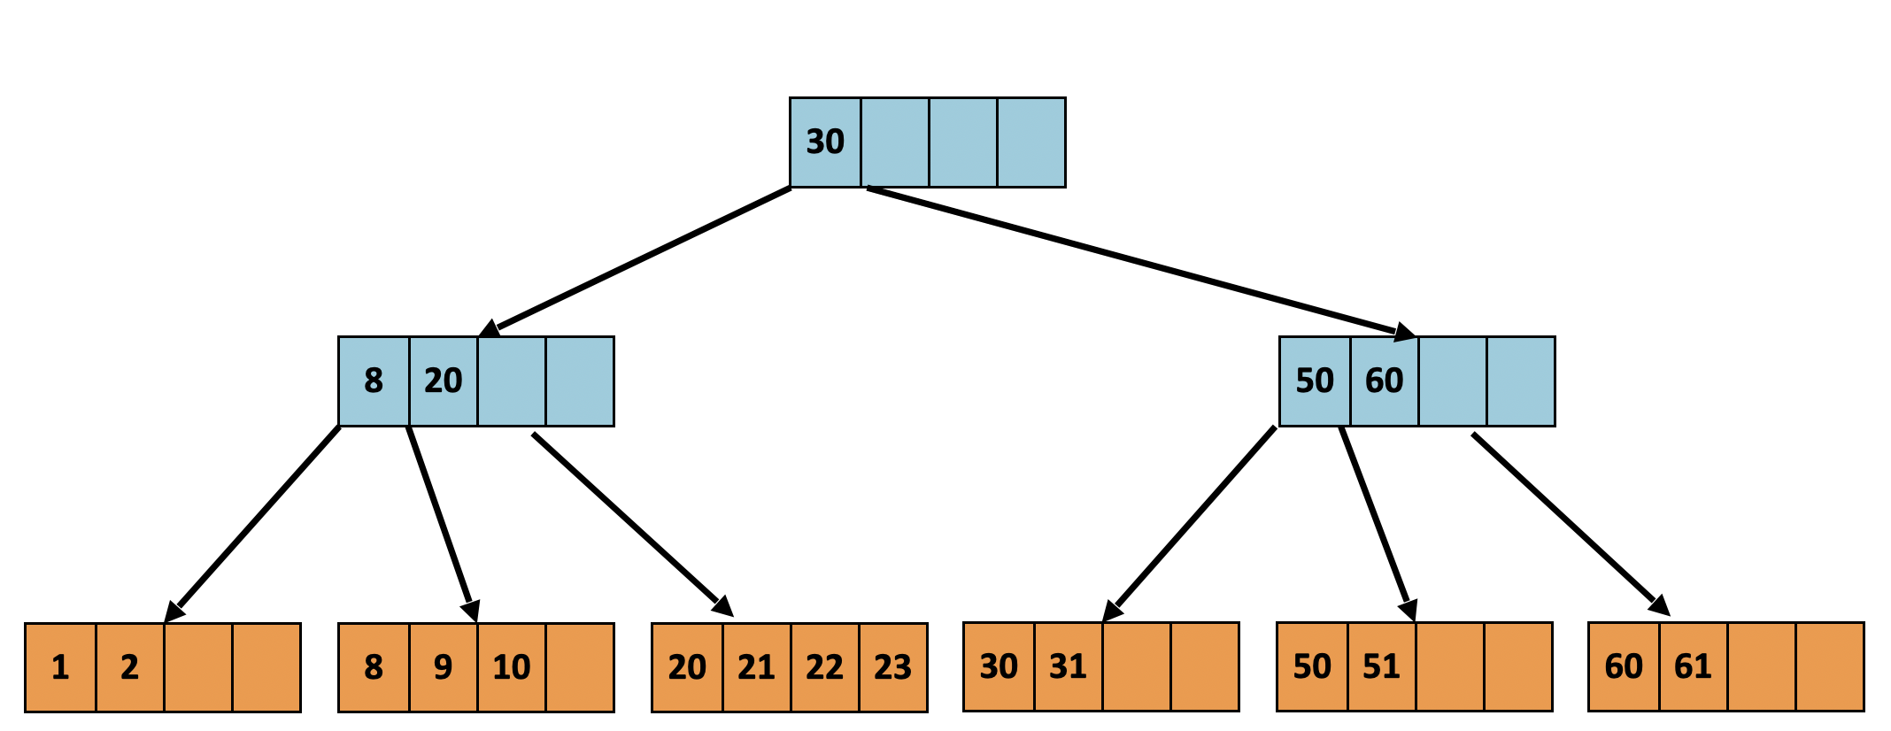
B-trees
B-trees are ubiquitous in theory/practice
Common pathology: Internal memory fragmentation
Notes:
B-trees is a data structure we all know and love. A common problem that they suffer from is internal memory fragmentation.

Slide 4
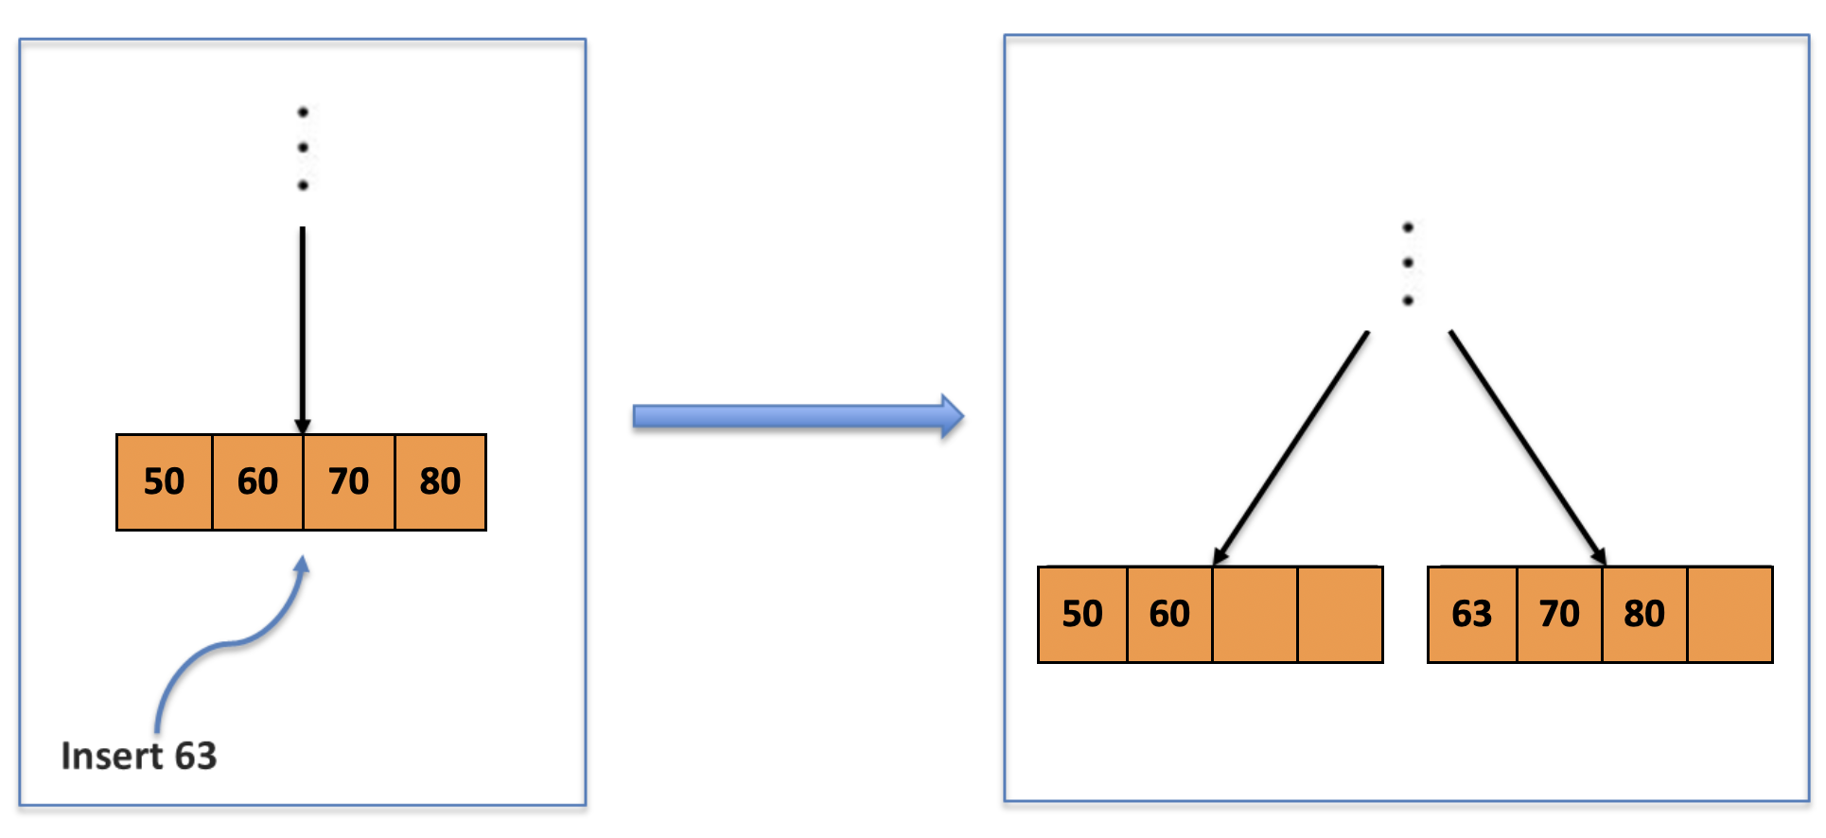
Internal Fragmentation
A full leaf gets split into two leaves
50% of newly allocated space is not utilized
Accumulation of unused space = int. Fragmentation
Notes:
When leaves are full in a B-tree, they get split into two leaves. Regardless of how the split is performed, 50% of the newly allocated space is unused, meaning contains no keys. Internal fragmentation refers to the accumulation of this unused space within the data structure.

Slide 5
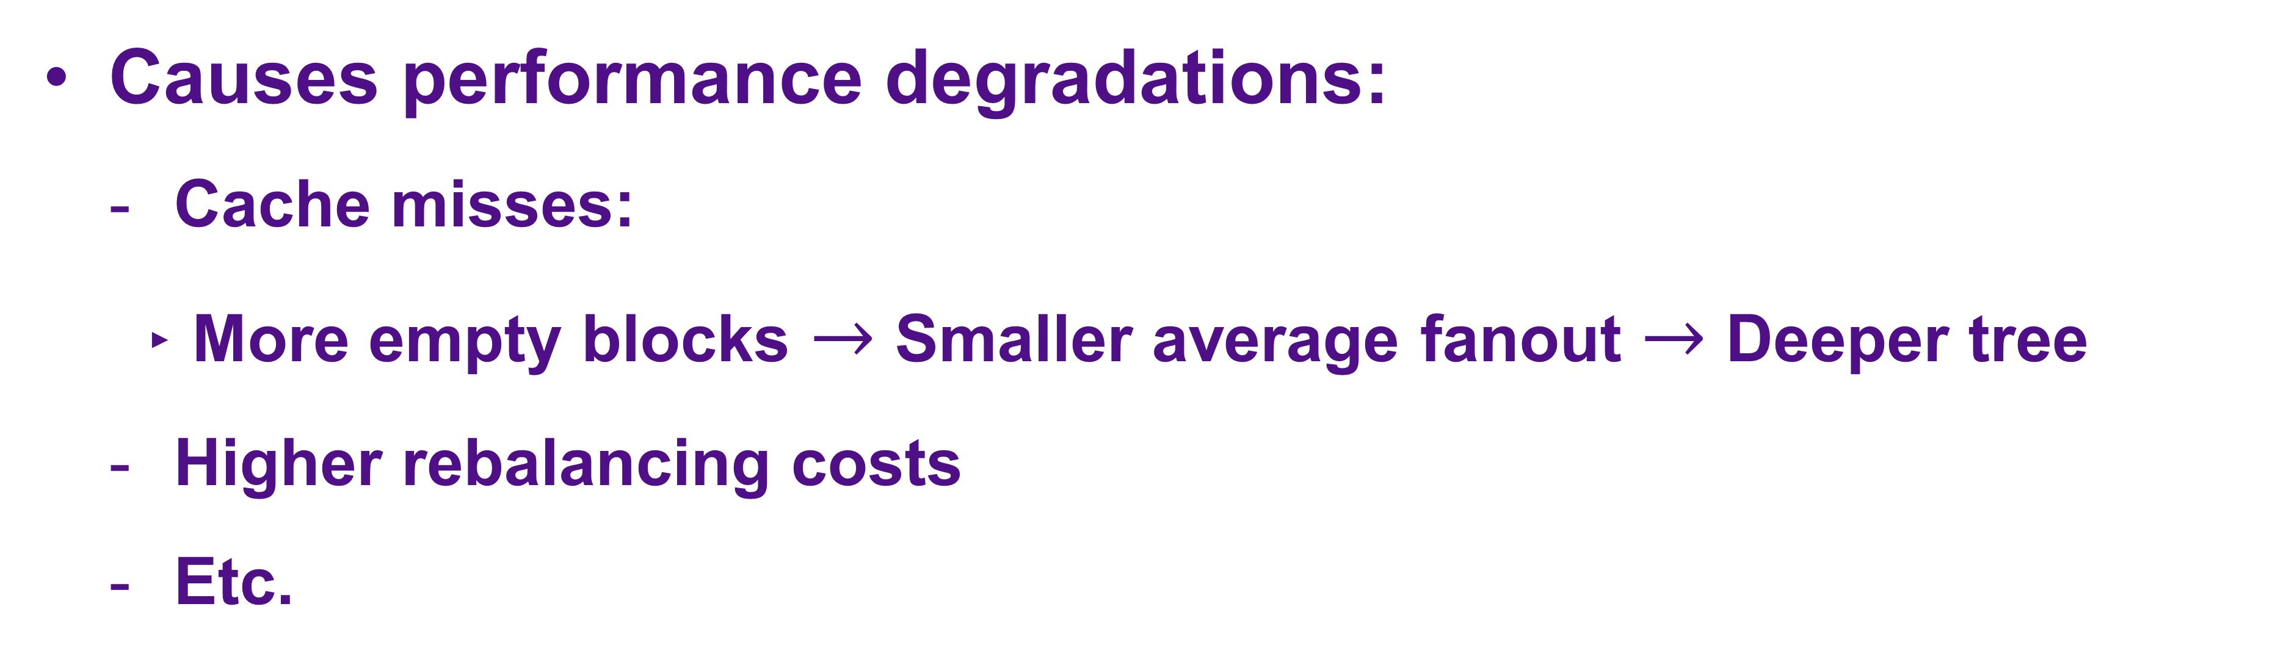
Internal Fragmentation
Causes performance degradations:
Cache misses:
More empty blocks $→$ Smaller average fanout $→$ Deeper tree
Higher rebalancing costs
Etc.
Notes:
Internal fragmentation causes a number of well-studied performance degradations. For example, as unused space accumulates in the tree, the average fanout decreases, and the height increases, this causes an increases in the number of cache misses. Our main objective is to study ways to minimize internal fragmentation.

Slide 6
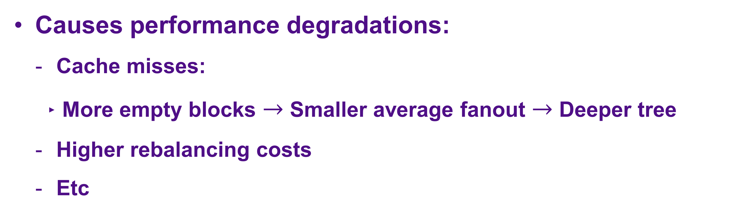
Internal Fragmentation
Causes performance degradations:
Cache misses:
More empty blocks $→$ Smaller average fanout $→$ Deeper tree
Higher rebalancing costs
Etc
Goal: Minimize internal fragmentation
Notes:
Internal fragmentation causes a number of well-studied performance degradations. For example, as unused space accumulates in the tree, the average fanout decreases, and the height increases, this causes an increases in the number of cache misses. Our main objective is to study ways to minimize internal fragmentation.

Slide 7
What Can We Do About It?
Splitting Decisions
Key Migration
Internal Fragmentation
Node Merging
Rebuild Tree
Notes:
Internal fragmentation causes a number of well-studied performance degradations. For example, as unused space accumulates in the tree, the average fanout decreases, and the height increases, this causes an increases in the number of cache misses. Our main objective is to study ways to minimize internal fragmentation.

Slide 8
What Can We Do About It?
Splitting Decisions
Key Migration
Internal Fragmentation
Node Merging
Expensive
Rebuild Tree
Notes:
Internal fragmentation causes a number of well-studied performance degradations. For example, as unused space accumulates in the tree, the average fanout decreases, and the height increases, this causes an increases in the number of cache misses. Our main objective is to study ways to minimize internal fragmentation.

Slide 9
What Can We Do About It?
Focus: Split wisely to minimize internal frag.
Splitting Decisions
Internal Fragmentation
Notes:
Internal fragmentation causes a number of well-studied performance degradations. For example, as unused space accumulates in the tree, the average fanout decreases, and the height increases, this causes an increases in the number of cache misses. Our main objective is to study ways to minimize internal fragmentation.

Slide 10
Model and Abstraction
Standard B-tree formulation: All keys stored in leaves.
Insertions only: When block is full need to decide on a split.
1 | 2 | 7
8 | 12 | 19
20 | 21 | 23 | 24 | 25
50 | 60 | 70 | 80 | 85
Notes:
For simplicity, we consider the problem through the following abstract lens. We store the keys in sorted order in a collection of blocks which represent the leaves. When inserts occur into full leaves, we need to decide how to split them.

Slide 11
Model and Abstraction
Standard B-tree formulation: All keys stored in leaves.
Insertions only: When block is full need to decide on a split.
Insert: 63
50 | 60 | 63 | 70 | 80
85
(A)
50 | 60 | 63 | 70
80 | 85
(B)
50 | 60 | 70 | 80 | 85
50 | 60 | 63
70 | 80 | 85
(C)
50 | 60
63 | 70 | 80 | 85
(D)
50
60 | 63 | 70 | 80 | 85
(E)
Notes:
So for example, if we insert 63 into the following full block, we have 5 different options for how to split the block and insert 63. Another way to think about this is we have a total of 6 keys if we include 63, and we have to decide on how to partition those keys in sorted order into two blocks.

Slide 12

Model and Abstraction
Standard B-tree formulation: All keys stored in leaves.
Insertions only: When block is full need to decide on a split.
Insert: 63
50 | 60 | 63 | 70 | 80
85
(A)
50 | 60 | 63 | 70
80 | 85
(B)
50 | 60 | 70 | 80 | 85
50 | 60 | 63
Even splitting
50 | 60 | 63
70 | 80 | 85
(C)
70 | 80 | 85
50 | 60
63 | 70 | 80 | 85
(D)
50
60 | 63 | 70 | 80 | 85
(E)
Notes:
We call (c) even splitting, since the keys are partitioned evenly in sorted order into the split blocks, we will come back to this specific splitting policy later.

Slide 13
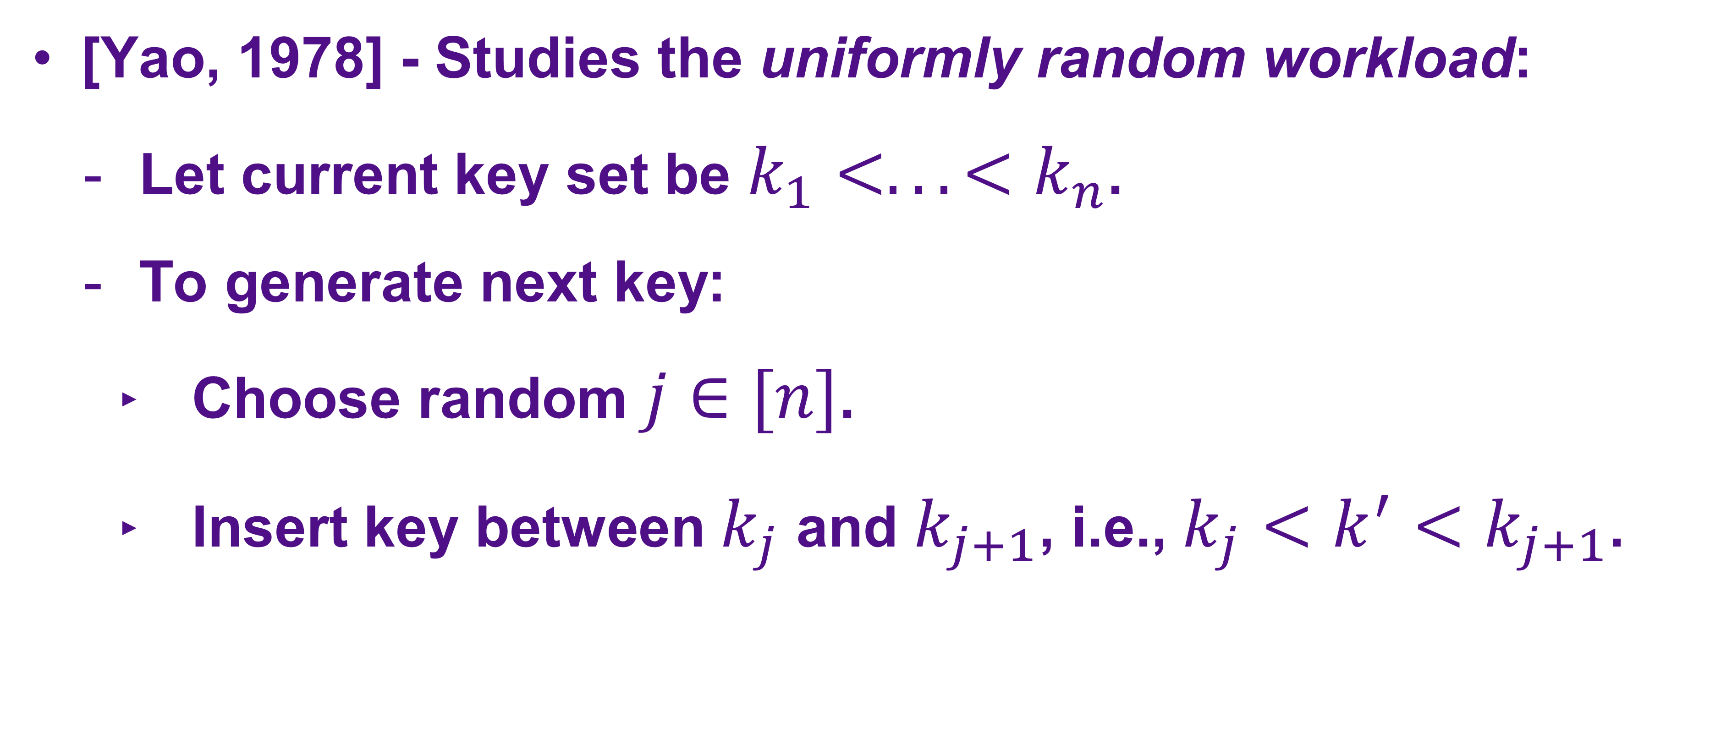
Previous Works
[Yao, 1978] - Studies the uniformly random workload:
Let current key set be $k_{1}<...<k_{n}$.
To generate next key:
Choose random $j∈[n]$.
Insert key between $k_{j}$ and $k_{j+1}$, i.e., $k_{j}<k^{′}<k_{j+1}$.
Notes:
Let’s talk about previous works. So Yao studied this problem in 1978 under a uniformly random model.

Slide 14
Uniformly Random Workload - Example
[Yao, 1978] - Studies the uniformly random workload.
1 | 2 | 7
8 | 12 | 15
18 | 23 | 25 | 30
37 | 41
Key set:
1 | 2 | 7 | 8 | 12 | 15 | 18 | 23 | 25 | 30 | 37 | 41
Notes:
Let’s talk about previous works. So Yao studied this problem in 1978 under a uniformly random model.

Slide 15

Uniformly Random Workload - Example
[Yao, 1978] - Studies the uniformly random workload.
Insert: 20
1 | 2 | 7
8 | 12 | 15
18 | 23 | 25 | 30
37 | 41
Key set:
1 | 2 | 7 | 8 | 12 | 15 | 18 | 23 | 25 | 30 | 37 | 41
Notes:
Let’s talk about previous works. So Yao studied this problem in 1978 under a uniformly random model.

Slide 16
Uniformly Random Workload - Example
[Yao, 1978] - Studies the uniformly random workload.
1 | 2 | 7
8 | 12 | 15
18 | 20 | 23 | 25 | 30
37 | 41
✅
Key set:
1 | 2 | 7 | 8 | 12 | 15 | 18 | 20 | 23 | 25 | 30 | 37 | 41
Notes:
Let’s talk about previous works. So Yao studied this problem in 1978 under a uniformly random model.

Slide 17
Uniformly Random Workload - Example
[Yao, 1978] - Studies the uniformly random workload.
Insert: 27
1 | 2 | 7
8 | 12 | 15
18 | 20 | 23 | 25 | 30
37 | 41
Key set:
1 | 2 | 7 | 8 | 12 | 15 | 18 | 20 | 23 | 25 | 30 | 37 | 41
Notes:
Let’s talk about previous works. So Yao studied this problem in 1978 under a uniformly random model.

Slide 18
Uniformly Random Workload - Example
[Yao, 1978] - Studies the uniformly random workload.
1 | 2 | 7
8 | 12 | 15
18 | 20 | 23
25 | 27 | 30
37 | 41
✅
Key set:
1 | 2 | 7 | 8 | 12 | 15 | 18 | 20 | 23 | 25 | 27 | 30 | 37 | 41
Notes:
Let’s talk about previous works. So Yao studied this problem in 1978 under a uniformly random model.

Slide 19
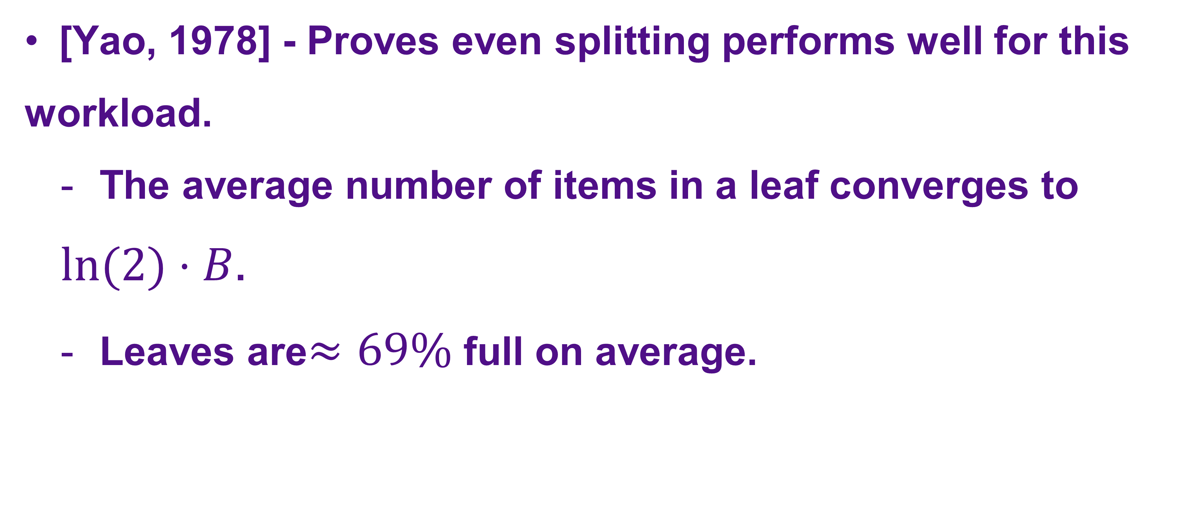
Previous Works
[Yao, 1978] - Proves even splitting performs well for this
workload.
The average number of items in a leaf converges to
$ln(2)⋅B$.
Leaves are$≈69\%$ full on average.
Notes:
Yao shows that even splitting performs quite well in this specific workload, leaves are 69% full on average, asymptotically. However, empirically, typical database workloads are different from Yao’s workload in that they are batched. More precisely, they are roughly a sequence of batches, where each batch is a run of consecutive keys inserted in one specific, seemingly random, location.
FIX FONT SIZE CHANGES!!

Slide 20
Previous Works
But typical database usage is batched: A consecutive run
of (multiple) keys is inserted at a (seemingly) random
position.
[Kim, 2002]
[Achakeev, Seeger, 2013], etc.
Notes:
Yao shows that even splitting performs quite well in this specific workload, leaves are 69% full on average, asymptotically. However, empirically, typical database workloads are different from Yao’s workload in that they are batched. More precisely, they are roughly a sequence of batches, where each batch is a run of consecutive keys inserted in one specific, seemingly random, location.

Slide 21
Previous Works
But typical database usage is batched: A consecutive run
of (multiple) keys is inserted at a (seemingly) random
position.
[Kim, 2002]
[Achakeev, Seeger, 2013], etc.
Specific focus: Model and analyze batched workloads
Notes:
Yao shows that even splitting performs quite well in this specific workload, leaves are 69% full on average, asymptotically. However, empirically, typical database workloads are different from Yao’s workload in that they are batched. More precisely, they are roughly a sequence of batches, where each batch is a run of consecutive keys inserted in one specific, seemingly random, location.

Slide 22
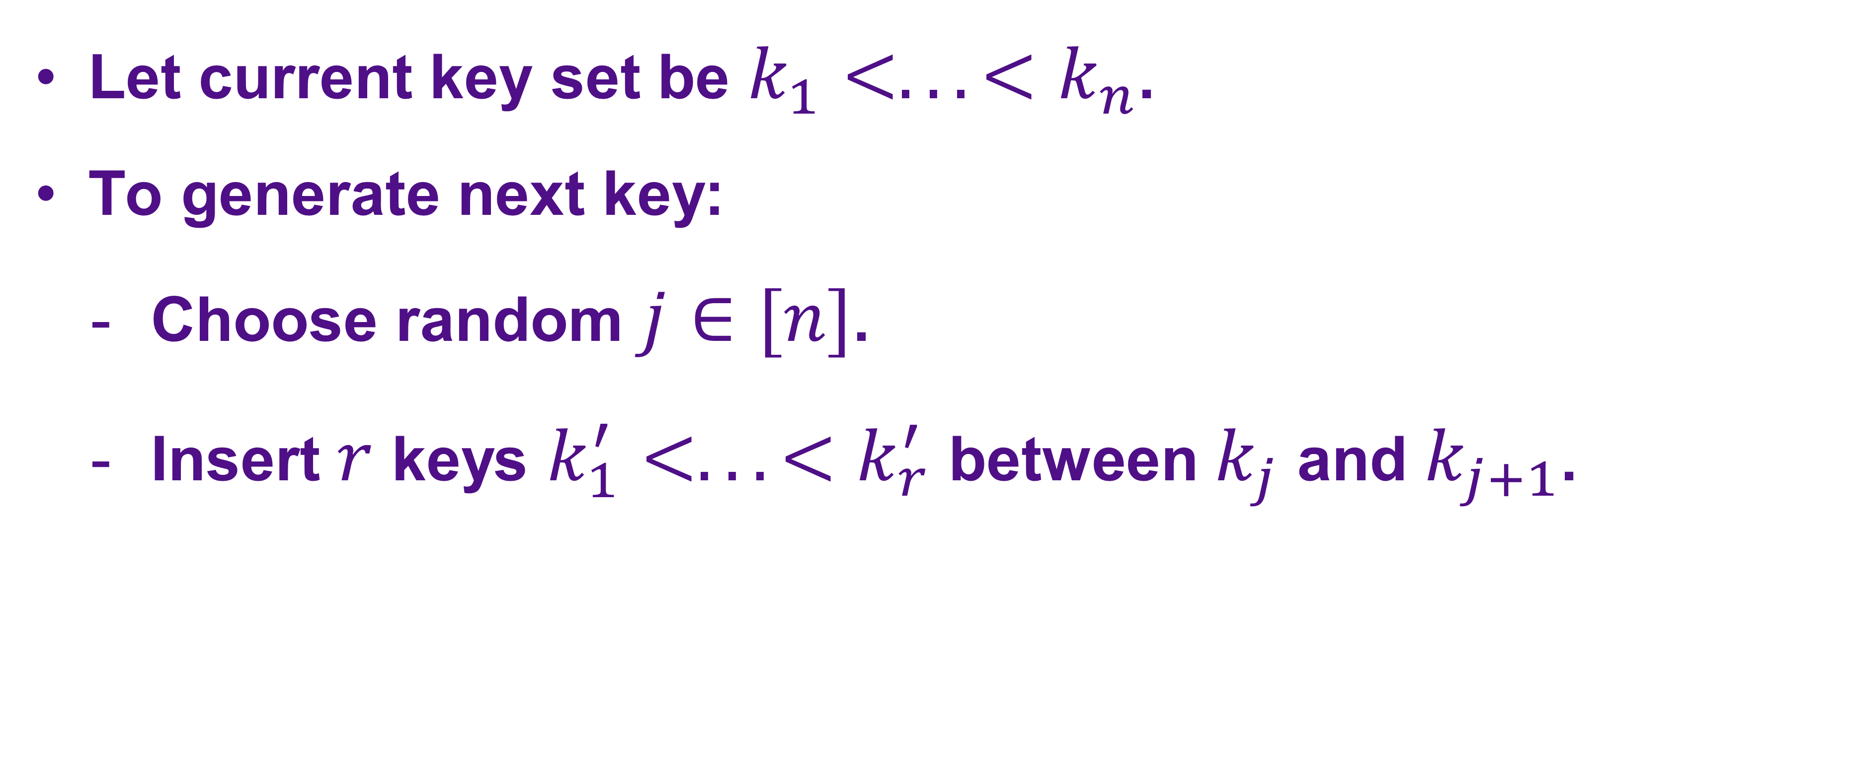
Batched Random Workloads
Let current key set be $k_{1}<...<k_{n}$.
To generate next key:
Choose random $j∈[n]$.
Insert $r$ keys $k_{1}^{′}<...<k_{r}^{′}$ between $k_{j}$ and $k_{j+1}$.
Notes:
First, for a formal model of batched workloads.

Slide 23
Batched Random Workloads
Let current key set be $k_{1}<...<k_{n}$.
To generate next key:
Choose random $j∈[n]$.
Insert $r$ keys $k_{1}^{′}<...<k_{r}^{′}$ between $k_{j}$ and $k_{j+1}$.
Parameterized workload.
Notes:
First, for a formal model of batched workloads.

Slide 24
Batched Random Workload Example: $r=4$
8 | 12 | 19
20 | 21 | 22 | 23
24 | 25 | 50
Key set:
8 | 12 | 19 | 20 | 21 | 22 | 23 | 24 | 25 | 50
Notes:
Let’s talk about previous works. So Yao studied this problem in 1978 under a uniformly random model.

Slide 25
Batched Random Workload Example: $r=4$
8 | 12 | 19
20 | 21 | 22 | 23
24 | 25 | 50
Key set:
8 | 12 | 19 | 20 | 21 | 22 | 23 | 24 | 25 | 50
Notes:
Let’s talk about previous works. So Yao studied this problem in 1978 under a uniformly random model.

Slide 26
Batched Random Workload Example: $r=4$
8 | 12 | 19
20 | 21 | 22 | 23
24 | 25 | 50
Key set:
8 | 12 | 19 | 20 | 21 | 22 | 23 | 24 | 25 | 50
Notes:
Let’s talk about previous works. So Yao studied this problem in 1978 under a uniformly random model.

Slide 27
Batched Random Workload Example: $r=4$
Insert: 30, 35 ,40 ,45.
8 | 12 | 19
20 | 21 | 22 | 23
24 | 25 | 50
Key set:
8 | 12 | 19 | 20 | 21 | 22 | 23 | 24 | 25 | 50
Notes:
Let’s talk about previous works. So Yao studied this problem in 1978 under a uniformly random model.

Slide 28
Batched Random Workload Example: $r=4$
Insert: 35 ,40 ,45.
8 | 12 | 19
20 | 21 | 22 | 23
24 | 25 | 30 | 50
Key set:
8 | 12 | 19 | 20 | 21 | 22 | 23 | 24 | 25 | 30 | 50
Notes:
Let’s talk about previous works. So Yao studied this problem in 1978 under a uniformly random model.

Slide 29
Batched Random Workload Example: $r=4$
Insert: 40 ,45.
8 | 12 | 19
20 | 21 | 22 | 23
24 | 25 | 30 | 35 | 50
Key set:
8 | 12 | 19 | 20 | 21 | 22 | 23 | 24 | 25 | 30 | 35 | 50
Notes:
Need to include graphics here demonstrating random insertions.

Slide 30
Batched Random Workload Example: $r=4$
Insert: 40 ,45.
8 | 12 | 19
20 | 21 | 22 | 23
24 | 25 | 30 | 35 | 50
Key set:
8 | 12 | 19 | 20 | 21 | 22 | 23 | 24 | 25 | 30 | 35 | 50
Notes:
Need to include graphics here demonstrating random insertions.

Slide 31
Batched Random Workload Example: $r=4$
Insert: 40 ,45.
8 | 12 | 19
20 | 21 | 22 | 23
24 | 25 | 30
35 | 50
Key set:
8 | 12 | 19 | 20 | 21 | 22 | 23 | 24 | 25 | 30 | 35 | 50
Notes:
Need to include graphics here demonstrating random insertions.

Slide 32
Batched Random Workload Example: $r=4$
Insert: 45.
8 | 12 | 19
20 | 21 | 22 | 23
24 | 25 | 30
35 | 40 | 50
Key set:
8 | 12 | 19 | 20 | 21 | 22 | 23 | 24 | 25 | 30 | 35 | 50
Notes:
Need to include graphics here demonstrating random insertions.

Slide 33
Batched Random Workload Example: $r=4$
8 | 12 | 19
20 | 21 | 22 | 23
24 | 25 | 30
35 | 40 | 45 | 50
✅
Key set:
8 | 12 | 19 | 20 | 21 | 22 | 23 | 24 | 25 | 30 | 35 | 50
Notes:
Need to include graphics here demonstrating random insertions.

Slide 34
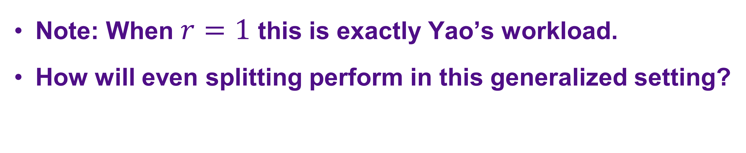
Batched Random Workload Example: $r=4$
8 | 12 | 19
20 | 21 | 22 | 23
24 | 25 | 30
35 | 40 | 45 | 50
✅
Key set:
8 | 12 | 19 | 20 | 21 | 22 | 23 | 24 | 25 | 30 | 35 | 50
Note: When $r=1$ this is exactly Yao’s workload.
How will even splitting perform in this generalized setting?
Notes:
Need to include graphics here demonstrating random insertions.

Slide 35
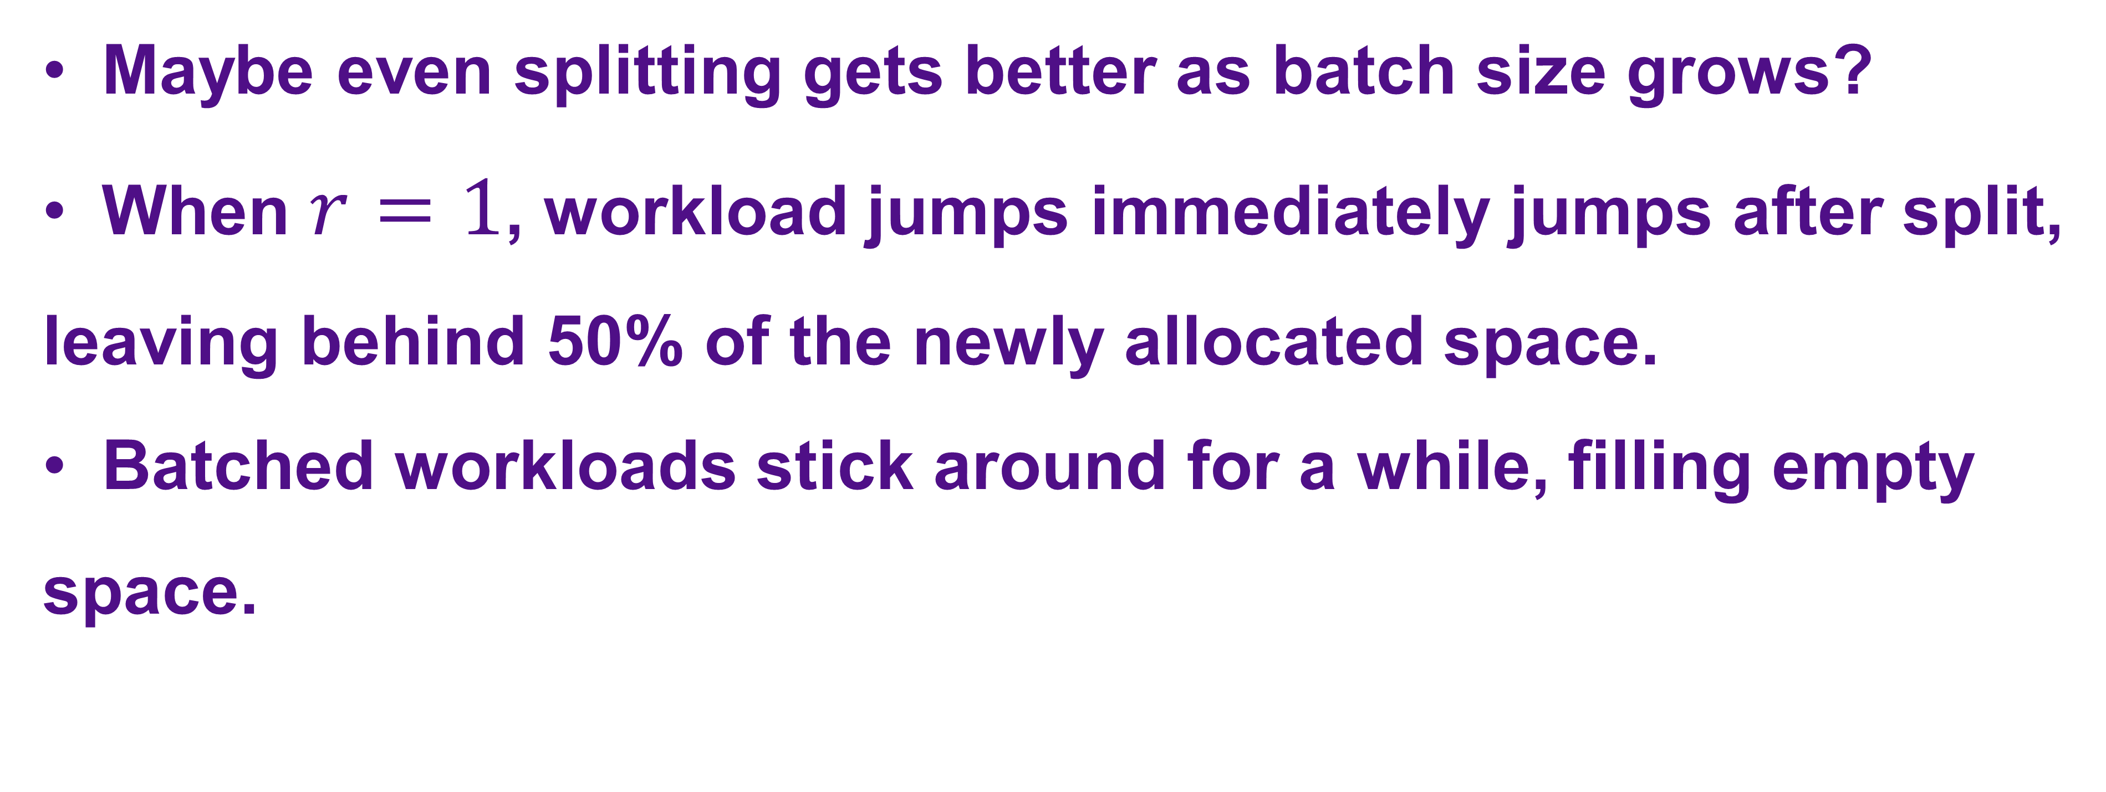
Intuition For Batched Workloads
Maybe even splitting gets better as batch size grows?
When $r=1$, workload jumps immediately jumps after split,
leaving behind 50% of the newly allocated space.
Batched workloads stick around for a while, filling empty
space.
Notes:
Intuitively it might seem things only get better, when r=1, the workload jumps to a random location immediately after a split is performed. Batched workloads potentially stick around for a while after a split, helping fill up some of the unused space.
TOO MUCH SOUNDTRACK, LEAVING BEHIND 50% OF THE NEW UNUSED SPACE HAS TO BE ON THE SLIDE.

Slide 36
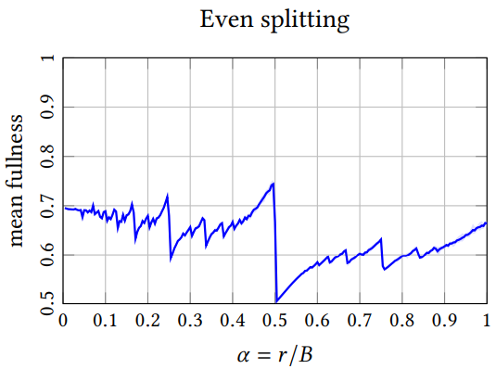
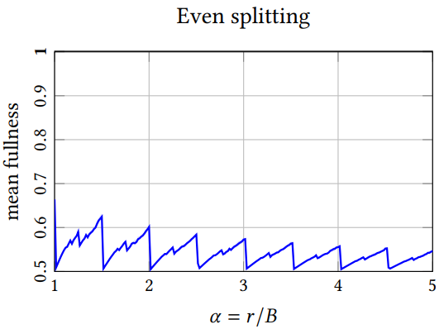
Intuition For Batched Workloads
Maybe even splitting gets better as batch size grows?
😀
😀
☹️
☹️
Notes:
Intuitively it might seem things only get better, when r=1, the workload jumps to a random location immediately after a split is performed. Batched workloads potentially stick around for a while after a split, helping fill up some of the unused space.
TOO MUCH SOUNDTRACK, LEAVING BEHIND 50% OF THE NEW UNUSED SPACE HAS TO BE ON THE SLIDE.

Slide 37
Intuition For Batched Workloads
Maybe even splitting gets better as batch size grows?
😀
😀
☹️
☹️
Fullness not monotonic or smooth in batch size.
Notes:
Intuitively it might seem things only get better, when r=1, the workload jumps to a random location immediately after a split is performed. Batched workloads potentially stick around for a while after a split, helping fill up some of the unused space.
TOO MUCH SOUNDTRACK, LEAVING BEHIND 50% OF THE NEW UNUSED SPACE HAS TO BE ON THE SLIDE.

Slide 38
Intuition For Batched Workloads
Maybe even splitting gets better as batch size grows?
😀
😀
☹️
☹️
Fullness not monotonic or smooth in batch size.
Fullness appears to converge to 0.5 for large batches.
Notes:
Intuitively it might seem things only get better, when r=1, the workload jumps to a random location immediately after a split is performed. Batched workloads potentially stick around for a while after a split, helping fill up some of the unused space.
TOO MUCH SOUNDTRACK, LEAVING BEHIND 50% OF THE NEW UNUSED SPACE HAS TO BE ON THE SLIDE.

Slide 39
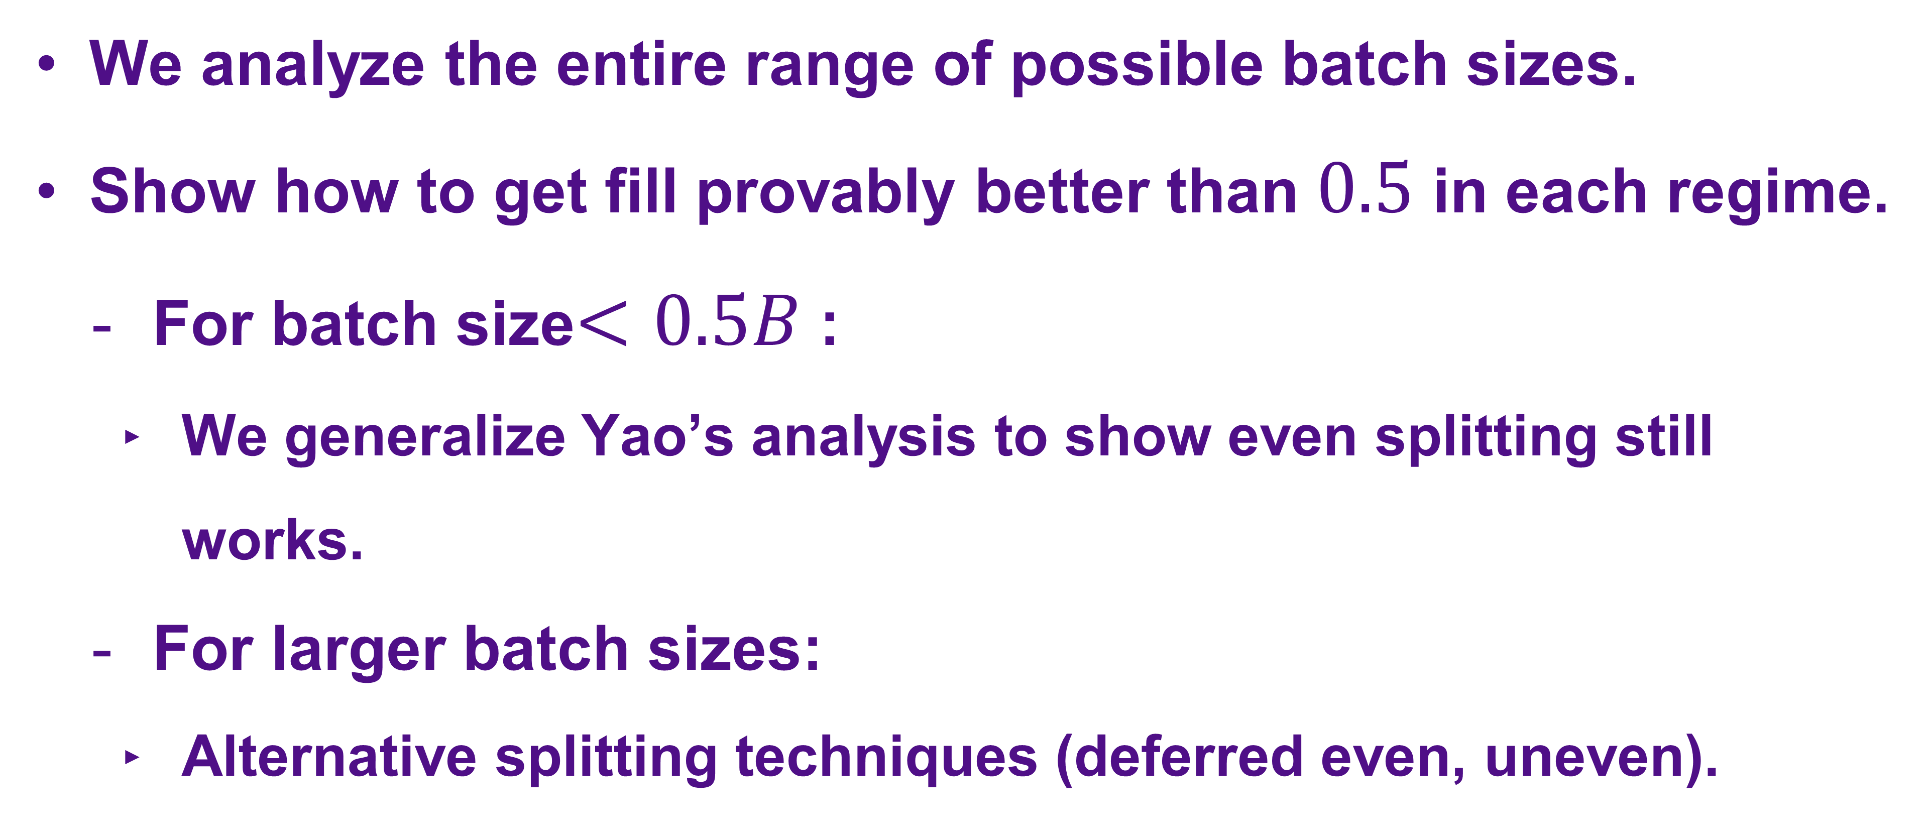
Main Contribution
We analyze the entire range of possible batch sizes.
Show how to get fill provably better than $0.5$ in each regime.
For batch size$<0.5B$ :
We generalize Yao’s analysis to show even splitting still works.
For larger batch sizes:
Alternative splitting techniques (deferred even, uneven).
Notes:
Our main contribution - we show how to get fill that is provably better than 0.5 by a constant margin in every batch-size regime. For small batch sizes, we generalize Yao’s analysis to show even splitting still works, and for larger batch sizes we introduce simple alternative splitting techniques.

Slide 40
Main Contribution
We analyze the entire range of possible batch sizes.
Show how to get fill provably better than $0.5$ in each regime.
For batch size$<0.5B$ :
We generalize Yao’s analysis to show even splitting still works.
For larger batch sizes:
Alternative splitting techniques (deferred even, uneven).
Main technical challenge
Notes:
Our main contribution - we show how to get fill that is provably better than 0.5 by a constant margin in every batch-size regime. For small batch sizes, we generalize Yao’s analysis to show even splitting still works, and for larger batch sizes we introduce simple alternative splitting techniques.

Slide 41
Yao’s Analysis

Slide 42
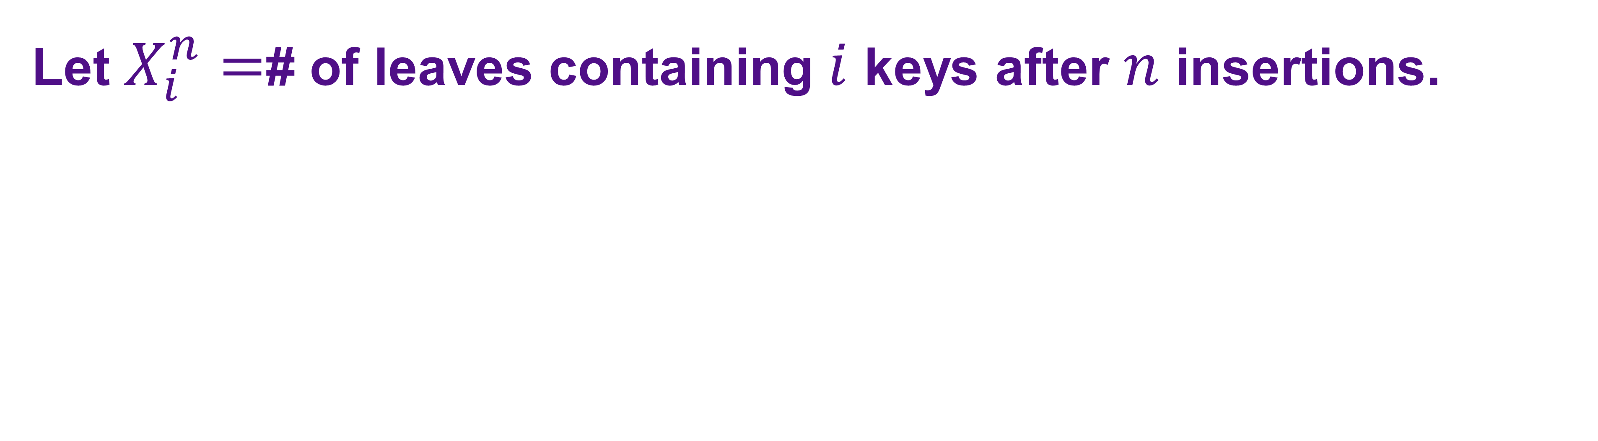
Yao’s Analysis
Let $X_{i}^{n}=$# of leaves containing $i$ keys after $n$ insertions.
1 | 2
8 | 9 | 10
20 | 21 | 22 | 23
25 | 29
30 | 31
50 | 51
60 | 61
Notes:
First, we define some random variables, we let X_i^n be the number of leaves containing i keys after a total of n keys have been inserted.

Slide 43



Yao’s Analysis
Let $X_{i}^{n}=$# of leaves containing $i$ keys after $n$ insertions.
$$X_{3}^{15}=1$$
$$X_{4}^{15}=1$$
$$X_{2}^{15}=5$$
1 | 2
8 | 9 | 10
20 | 21 | 22 | 23
25 | 29
30 | 31
50 | 51
60 | 61
Notes:
So for example… REARRANGE THIS HORIZONTALLY.

Slide 44
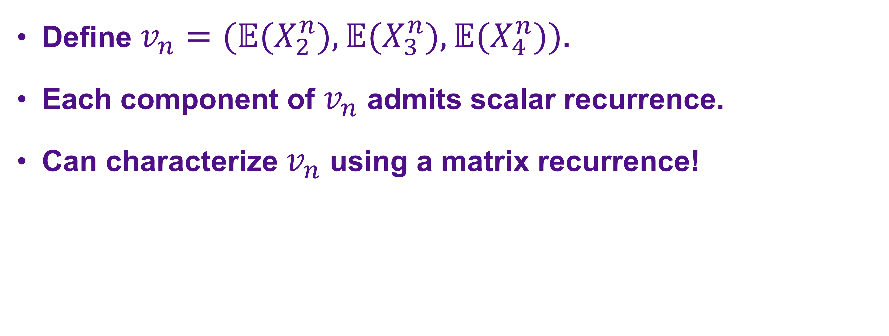
Yao’s Analysis
Define $v_{n}=(𝔼(X_{2}^{n}),𝔼(X_{3}^{n}),𝔼(X_{4}^{n}))$.
Each component of $v_{n}$ admits scalar recurrence.
Can characterize $v_{n}$ using a matrix recurrence!
Notes:
We can use these random variables to define a sequence of vectors - each vector’s components are the expected values of the corresponding random variables. The proportions between these expectations, i.e., the entries of the vector, correspond to the proportions between the quantities of leaves of different fill. So the goal is to study v_n’s asymptotic behavior in order to analyze the average block size. To achieve this, Yao observes each component of this vector has a corresponding scalar recurrence. So, v_n admits a matrix recurrence.
PUT IN FORMULA TO SHOW THE RELATIONSHIP BETWEEN AVERAGE FILL AND THE PROPORTIONS OF THE DIFFERENT COMPONENTS OF V_N.

Slide 45
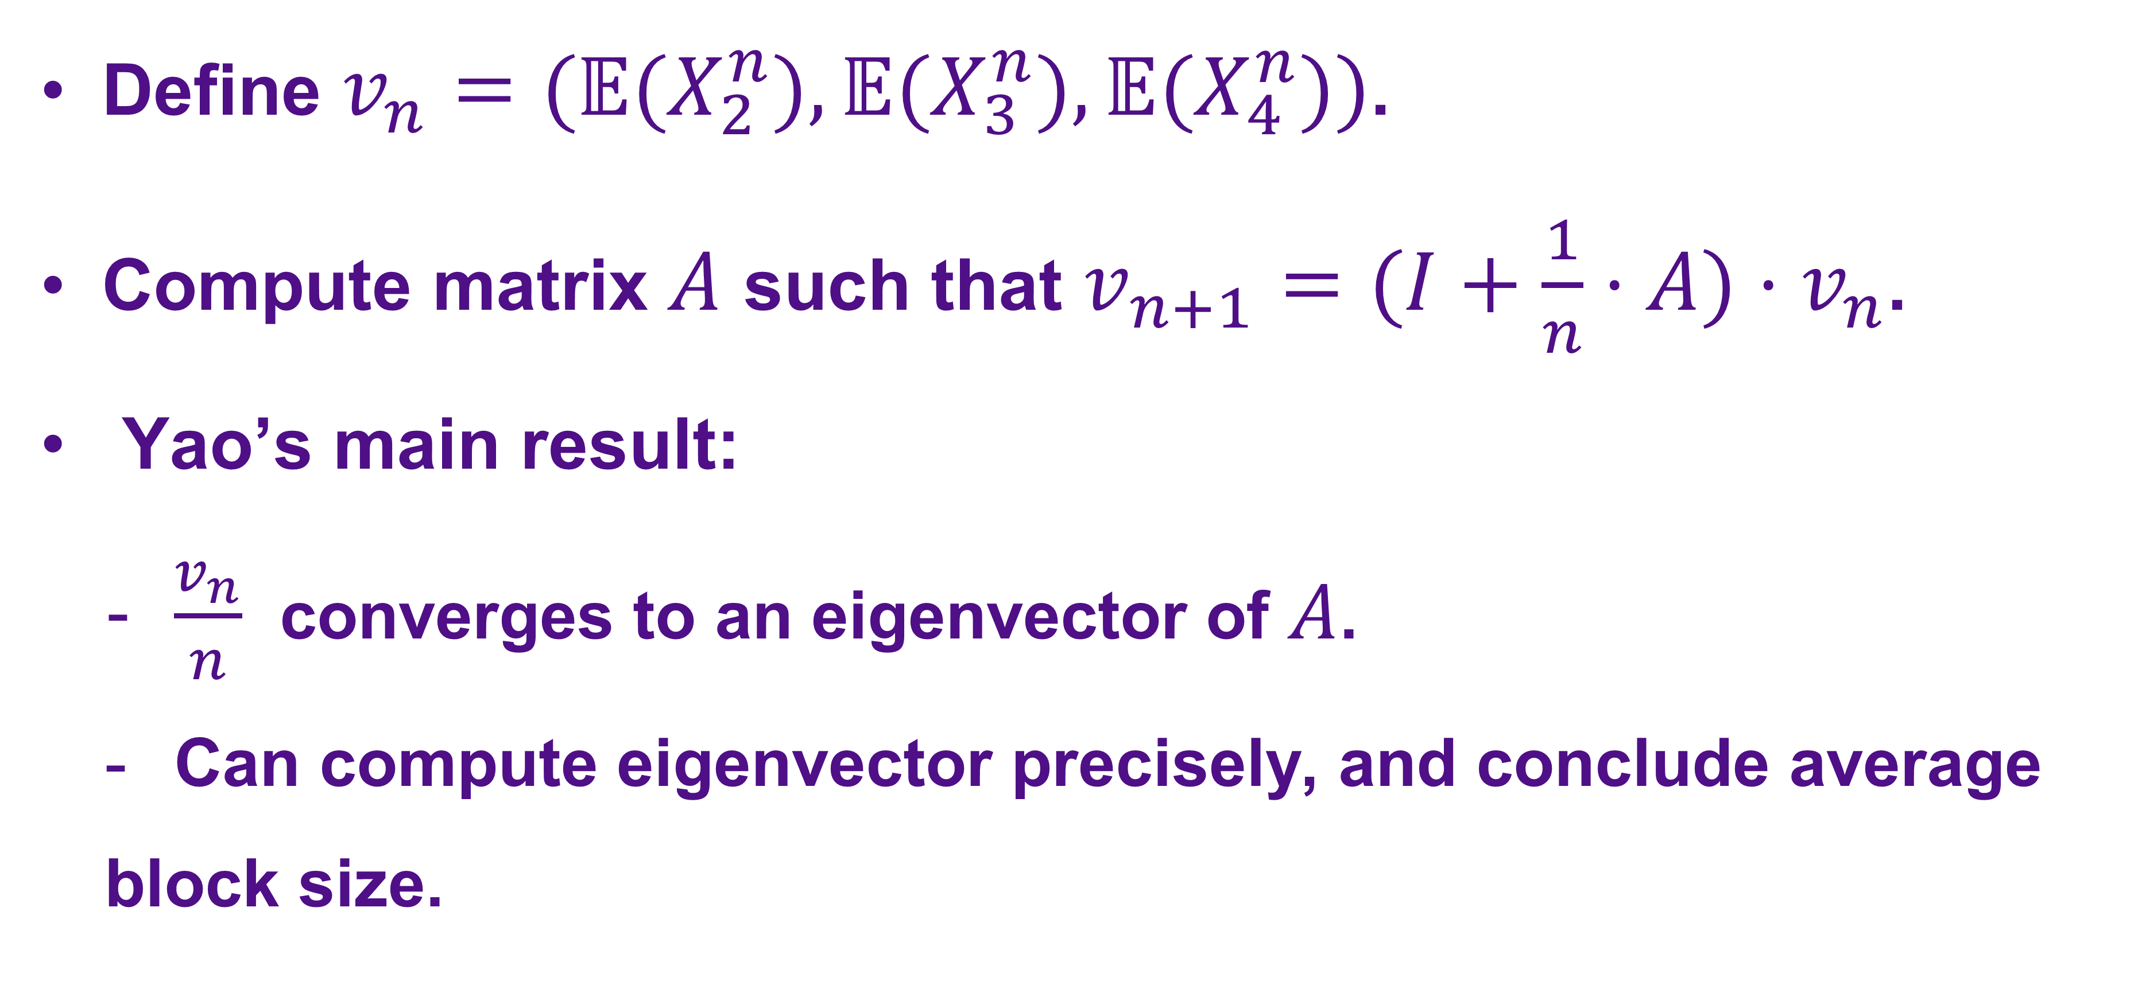
Yao’s Analysis
Define $v_{n}=(𝔼(X_{2}^{n}),𝔼(X_{3}^{n}),𝔼(X_{4}^{n}))$.
Compute matrix $A$ such that $v_{n+1}=(I+\frac{1}{n}⋅A)⋅v_{n}$.
Yao’s main result:
$\frac{v_{n}}{n}$ converges to an eigenvector of $A$.
Can compute eigenvector precisely, and conclude average
block size.
Notes:
More specifically, one can compute a matrix A such that the following equality holds. Yao’s main result is that the average block size converges to an eigenvector of A, and the eigenvector can be analyzed precisely to conclude the average block size.

Slide 46

Generalizing Yao’s approach
Factoring characteristic polynomial to characterize $σ(A)$
Problem: Infeasible in the general case
Solution: Structurally characterize $A$: Irreducible Metzler
Proving $\frac{v_{n}}{n}$ converges to eigenvector by exploiting $A$’s diagonalizability
Problem: $A$ is not diagonalizable for $r>1$
Solution: Argue convergence using complex Jordan form
Precisely computing eigenvector
Problem: Infeasible in the general case
Solution: Analyze properties of the eigenvector for lower bounds

Slide 47
Generalizing Yao’s approach
Factoring characteristic polynomial to characterize $σ(A)$
Problem: Infeasible in the general case
Solution: Structurally characterize $A$: Irreducible Metzler
Proving $\frac{v_{n}}{n}$ converges to eigenvector by exploiting $A$’s diagonalizability
Problem: $A$ is not diagonalizable for $r>1$
Solution: Argue convergence using complex Jordan form
Precisely computing eigenvector
Problem: Infeasible in the general case
Solution: Analyze properties of the eigenvector for lower bounds

Slide 48
Generalizing Yao’s approach
Factoring characteristic polynomial to characterize $σ(A)$
Problem: Infeasible in the general case
Solution: Structurally characterize $A$: Irreducible Metzler
Proving $\frac{v_{n}}{n}$ converges to eigenvector by exploiting $A$’s diagonalizability
Problem: $A$ is not diagonalizable for $r>1$
Solution: Argue convergence using complex Jordan form
Precisely computing eigenvector
Problem: Infeasible in the general case
Solution: Analyze properties of the eigenvector for lower bounds

Slide 49
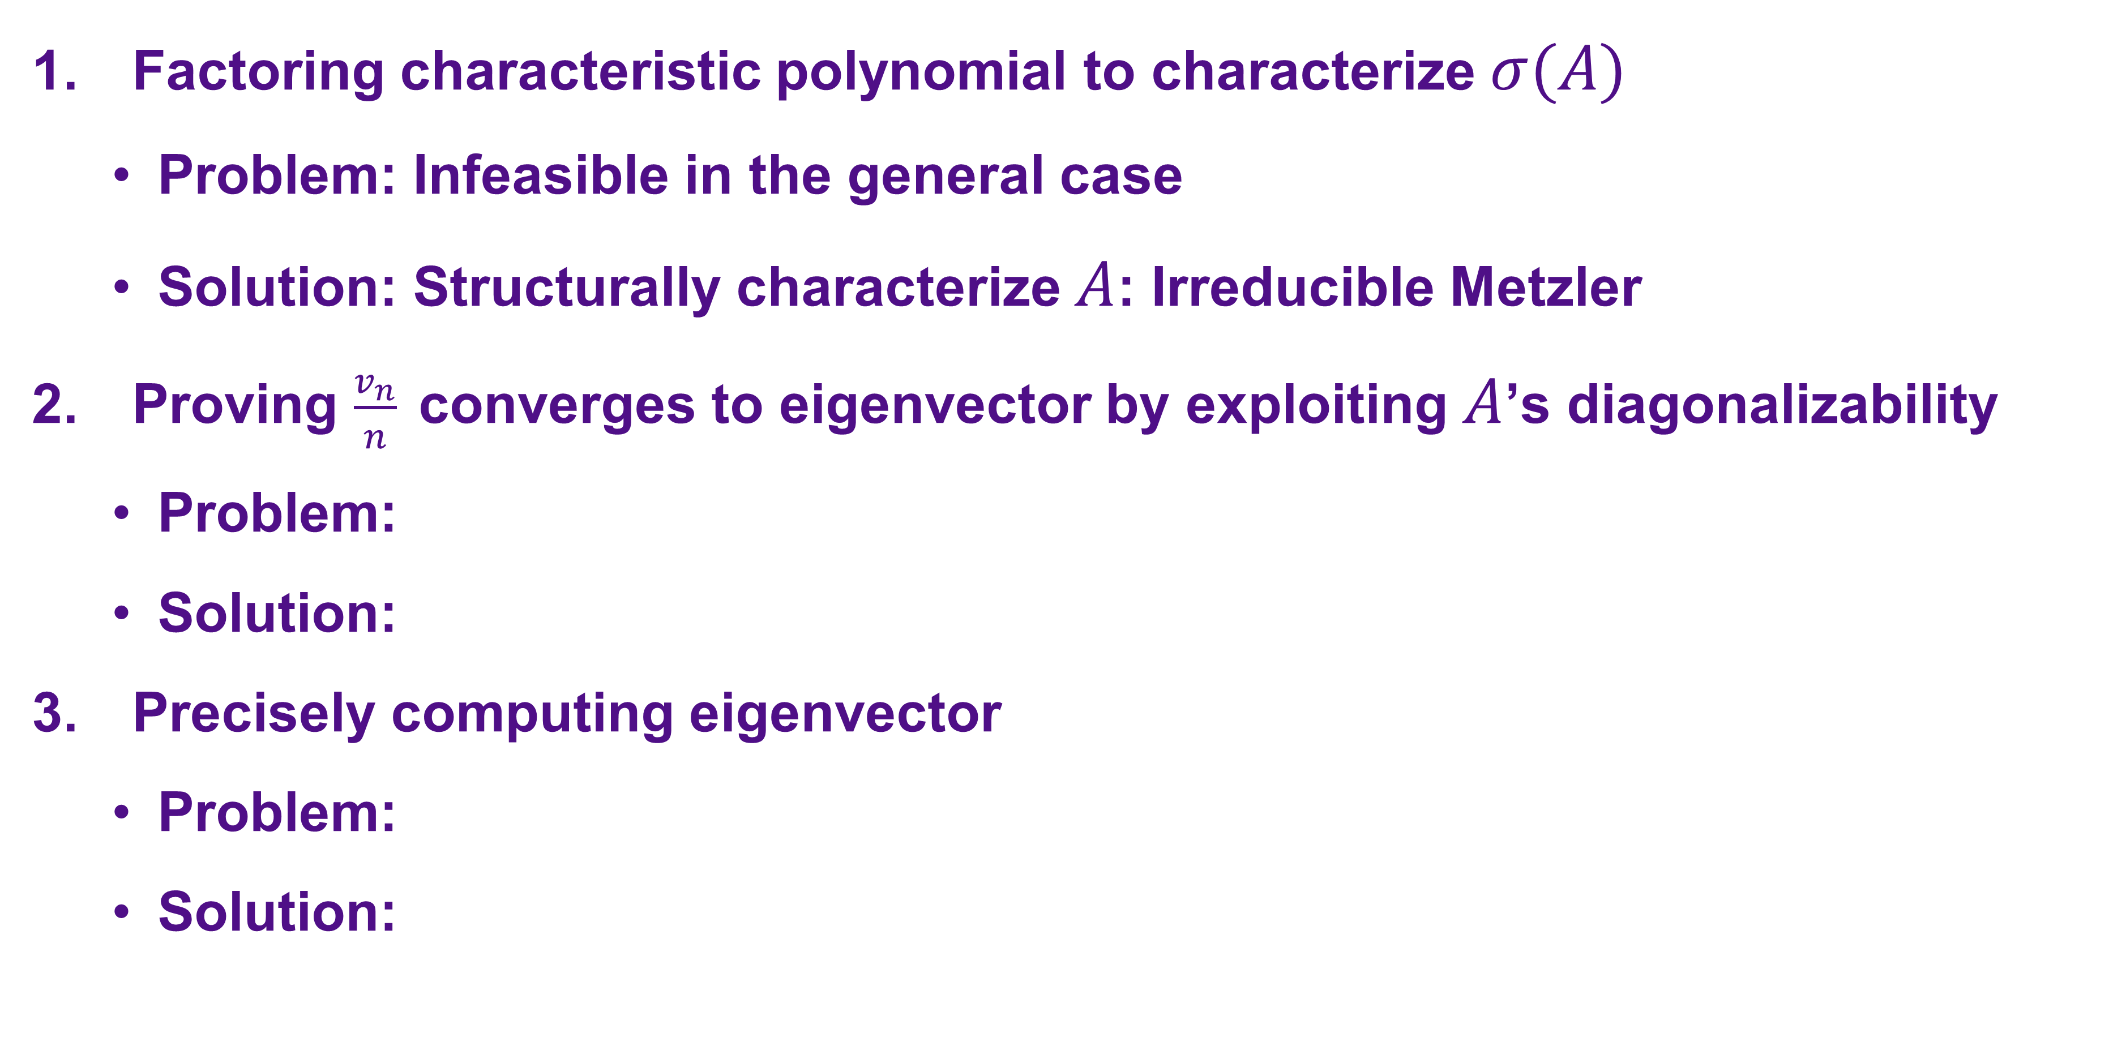
Generalizing Yao’s approach
Factoring characteristic polynomial to characterize $σ(A)$
Problem: Infeasible in the general case
Solution: Structurally characterize $A$: Irreducible Metzler
Proving $\frac{v_{n}}{n}$ converges to eigenvector by exploiting $A$’s diagonalizability
Problem:
Solution:
Precisely computing eigenvector
Problem:
Solution:

Slide 50
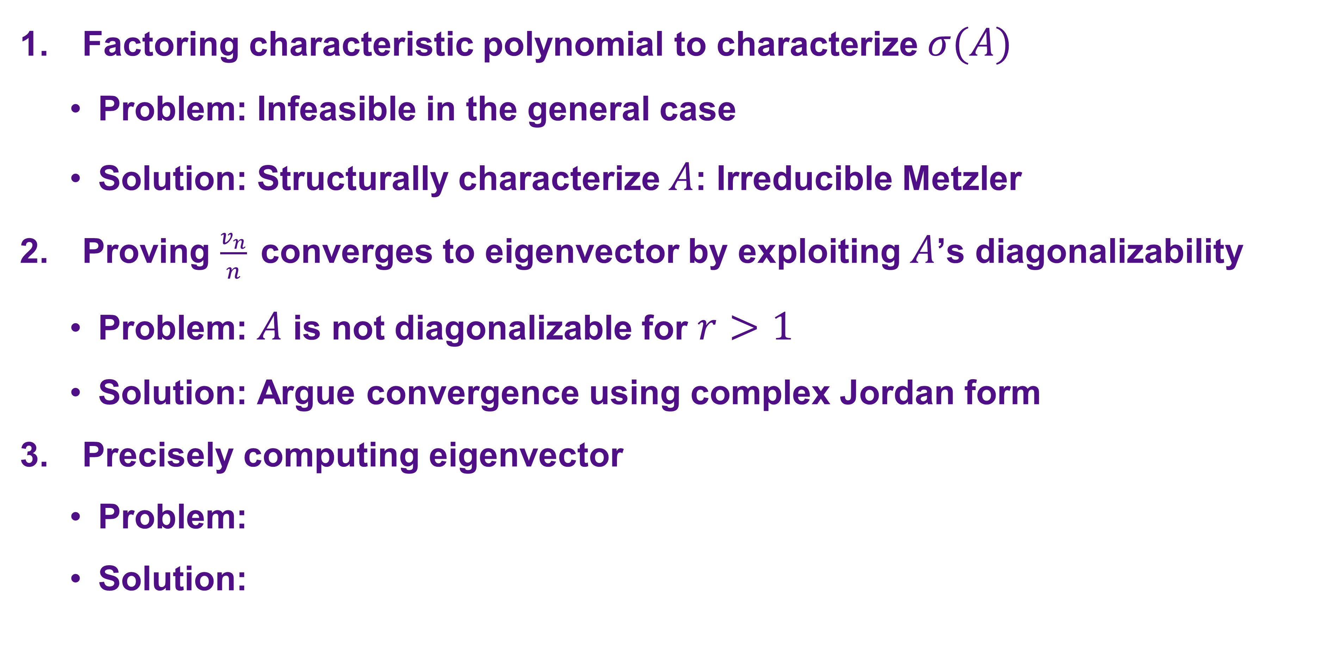
Generalizing Yao’s approach
Factoring characteristic polynomial to characterize $σ(A)$
Problem: Infeasible in the general case
Solution: Structurally characterize $A$: Irreducible Metzler
Proving $\frac{v_{n}}{n}$ converges to eigenvector by exploiting $A$’s diagonalizability
Problem: $A$ is not diagonalizable for $r>1$
Solution: Argue convergence using complex Jordan form
Precisely computing eigenvector
Problem:
Solution:

Slide 51
Generalizing Yao’s approach
Factoring characteristic polynomial to characterize $σ(A)$
Problem: Infeasible in the general case
Solution: Structurally characterize $A$: Irreducible Metzler
Proving $\frac{v_{n}}{n}$ converges to eigenvector by exploiting $A$’s diagonalizability
Problem: $A$ is not diagonalizable for $r>1$
Solution: Argue convergence using complex Jordan form
Precisely computing eigenvector
Problem: Infeasible in the general case
Solution: Analyze properties of the eigenvector for lower bounds

Slide 52
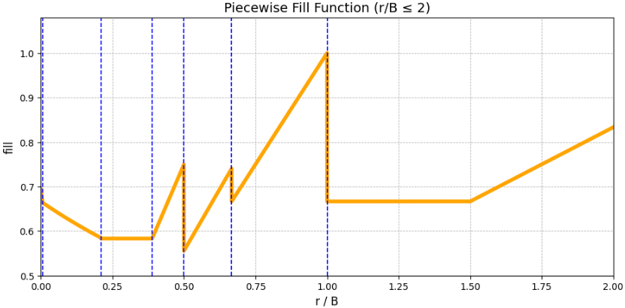
Fill at Different Regimes
Even splitting
Uneven splitting
Deferred even splitting

Slide 53
Oblivious Adversaries

Slide 54
From Random to Oblivious
Random setting: insertion position is freshly sampled.
Oblivious setting: the entire insertion sequence is fixed in advance.
The algorithm may be randomized.
The adversary does not see the random coins.

Slide 55
Same Game, Harder Input
Still: when a block overflows, choose an irrevocable split.
Still: measure average leaf fullness.
Now randomness belongs to the algorithm, not the workload.
Question: can randomization guarantee fullness above 1/2 for every fixed sequence?

Slide 56
Splitting Tree View
Each split creates two children in a binary tree.
The current leaves form a frontier of this tree.
A future insertion follows one root-to-leaf path.
Lower-bound idea: force many leaves to stop receiving insertions while underfull.

Slide 57
Deterministic Algorithms
Even splitting gives the trivial 1/2 guarantee.
Against deterministic algorithms, an adaptive adversary can force no better.
So the interesting case is randomized algorithms against oblivious sequences.
The sequence is fixed, but it can still encode a trap.

Slide 58
The Twiddle Workload
Maintain a cursor between two neighboring keys.
Insert alternately to the left and right of the cursor.
For restricted algorithms, one sibling is abandoned after each split.
The abandoned leaves have average fullness at most 2/3.

Slide 59
Randomized Twiddle
Make the order unpredictable: left-right or right-left.
To keep filling both siblings, the algorithm must repeatedly guess the next side.
A wrong guess leaves an underfull sibling behind.
For large B, repeatedly guessing correctly has tiny probability.

Slide 60
What This Suggests
Oblivious sequences can still contain traps for randomized algorithms.
The twiddle argument points toward a 2/3 barrier for online fullness.
The notes also explore a stronger two-stage attack near 0.655.
Offline/lookahead variants can do much better, so online uncertainty is central.

Slide 61
Open Questions
Is even splitting optimal against Yao's workload?
Can we get tight bounds for even splitting against batched insertions?
Can one splitting rule beat 1/2 without knowing r?
What is the exact threshold against oblivious adversaries?
How much lookahead is enough to beat the online barriers?

Slide 62
Questions?
Notes:
FOR MARTIN TO KEEP IN MIND: OUR BATCHED WORKLOAD I DON’T THINK IS UNIFORMLY RANDOM. LIKE I THINK IT’S FINE TO CALL IT BATCHED AS OPPOSED TO UNIFORMLY RANDOM. ALSO LAST SLIDES NEED DISCUSSION.

